Slide 1

IMPROVING SUPPLY CHAIN for Late Delivery Risk
A Statistical Analysis with actionable insights.
A Project Report By Pradeep Panicker

Slide 2
Business Problem Statement -
Business Scenario -
The company is engaged in TRADING ITEMS - receiving orders from its customers and delivering it to the End-Users located at different delivery locations, Globally., from its warehouses.
Business Synopsis –
Problem Statement -
54.8% of the ORDERS are LATE DELIVERED.
ORDERS WITH MAXIMUM-PROFIT ARE LATE DELIVERED.
Business Threat –
CUSTOMER CHURN FROM HIGH PROFITABILITY SECTOR DUE TO LATE DELIVERY RISK.
DATASET PERIOD | JAN 2015 ~ JAN 2018
NUMBER OF TRANSACTION | 180,519.00
NUMBER OF CUSTOMER ORDERS | 65,752.00
CATEGORY OF ITEMS | 50.00
NUMBER OF ITEMS SOLD | 118.00
CUSTOMER ORDERS GENERATED FROM | TWO COUNTRIES - USA & PURITO RICO
CONSUMER CATEGORY | 3.00
ORDERS DELIVERED TO | 05 MARKET REGIONS
ORDERS DELIVERED TO | 164 COUNTRIES
TOTAL SALES VALUE | $ 33,054,402.00
TOTAL PROFIT VALUE | $ 3,966,903.00
TOTAL DISCOUNT PROVIDED | $ 3,730,378.00

Slide 3
Constraints ; Scope & Objectives of the project -
Constraints Faced – NIL
Scope –
STATISTICAL VALIDATION OF DATASET.
Draw INSIGHTS from Exploratory Data Analysis
Choose appropriate Statistical Models.
Derive actionable insights and prescribe recommendations.
Objectives –
Provide actionable insights to the company management, by which supply-chain methodology is improved.
Improvement ensures ‘Late Delivery Risk’ reduction substantially thereby ensuring Customer retention.

Slide 4
Statistical Modelling- Importance
Importance –
Statistical Modeling of data generates an environment where –
  The correlation between the predictor variables can be quantitatively understood – CORRELATION PLOT WAS USED AND ANALYSED
  The variables significantly contributing to the variations in the Target variable- ‘Late Delivery Risk’ can be evaluated and defined – CHI.SQ. TEST FOR SIGNIFICANCE WAS CARRIED OUT ON ALL 50 VARIABLES. 28 VARIABLES WERE SELECTED.
  Dimensionality Reduction was carried out using PCA Analysis – 28 variables were reduced to 11 Principal Variables.
  Probability of occurrence of a significant predictor variable can be evaluated – under the given circumstances. – LOGISTICS REGREESION Model & CART Model was built and Tuned.
  Each significant variable can be classified according to its importance in creating variance on the target variable – ODDS Coefficient Analysis for Logit Model & IMPORANT VARIABLE Plot for CART was analyzed.
  ‘CART’ MODEL WAS CHOSEN OVER ‘LOGIT’ MODEL DUE TO BETTER MODEL VALIDATION AS WELL AS SELECTING OPTIMUM SIGNIFICANT VARIABLES.

Slide 5
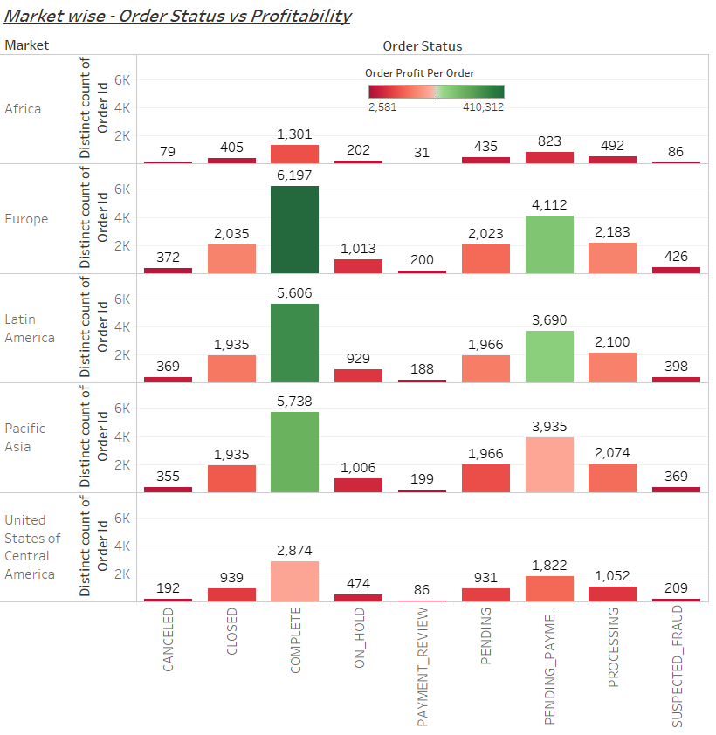
Statistical Modelling- Approach
Approach –
Exploratory Data Analysis has revealed that the PAYMENT Accounting system is ROBUST as well as INVENTORY Position of Items is at its best [ 100% stock availability]
Sales & Profitability is directly related.

Slide 6
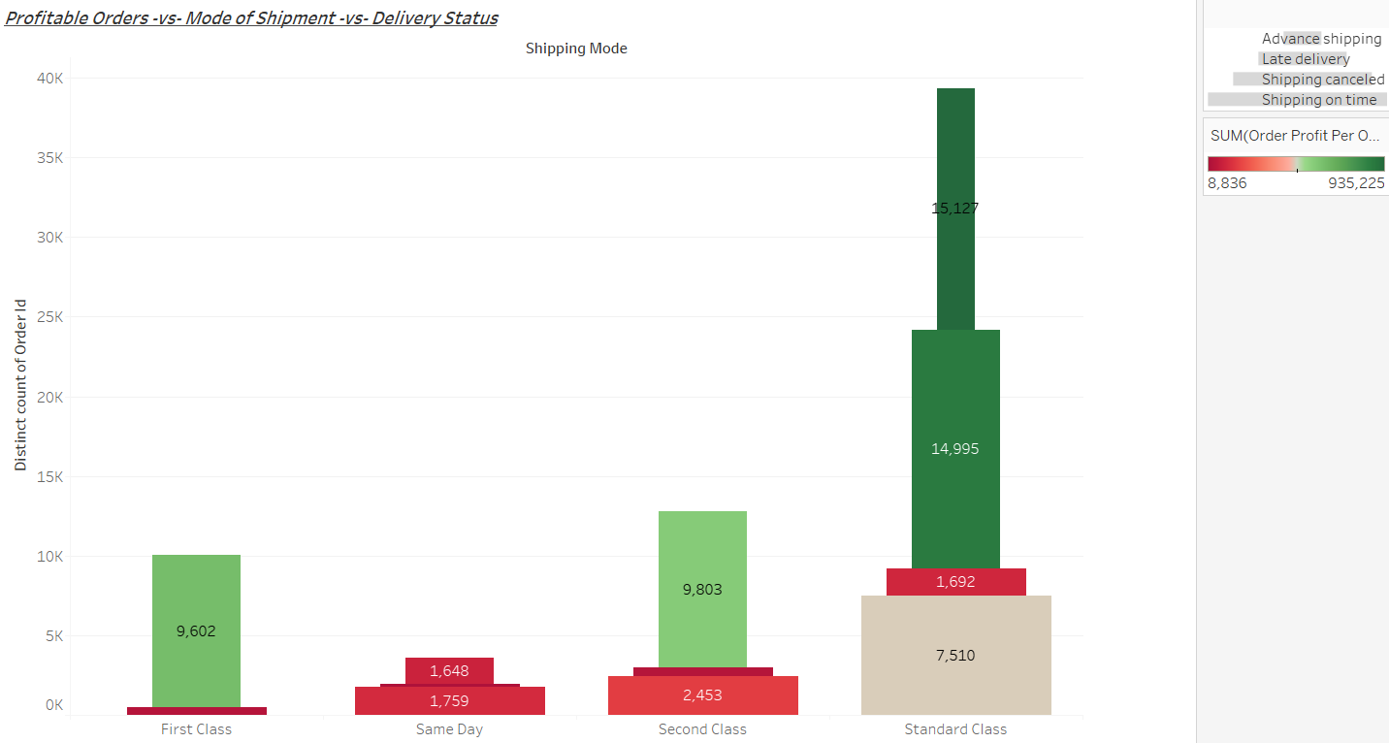
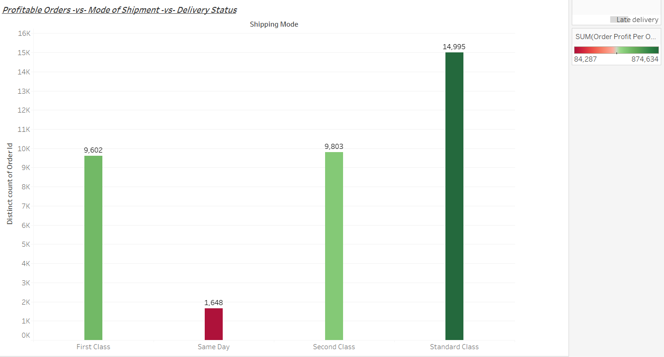
Statistical Modelling- Approach
ALL HIGH-PROFITABLE ORDERS ARE DELIVERED LATE ➔
Approach (contd . . . .)–
TO DERIVE AND UNDERSTAND THE SIGNIFICANT VARIABLES THAT CONTRIBUTE TO THE ‘LATE-DELIVERY RISK’ – WE WILL BE UTILISING
CART(Classification And Regression Tree) I
CART – Classifies the whole data into a Tree with different Branches – wherein the Trunk of the tree is the MOST IMPORTANT Variable that effects the ‘Late Delivery Risk’ and thereby the Tree branches out showing the lesser significant variables with its individual impact on ‘Late Delivery Risk’

Slide 7
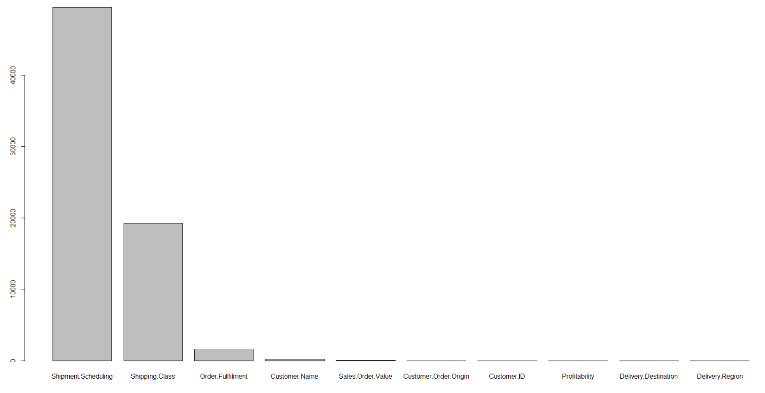
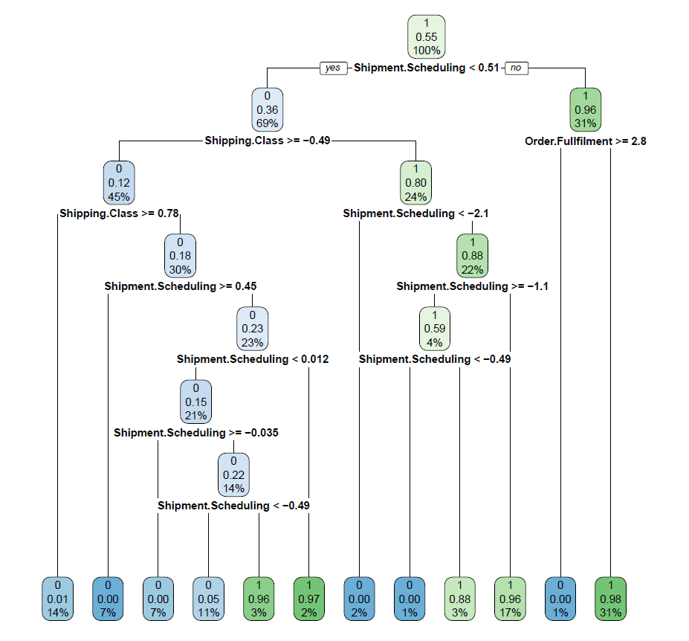
INSIGHTS – from Statistical Modelling
Importance variable plot reveals that ‘Shipment Scheduling’ ,‘Shipping Class’ & ‘Order Fulfillment’ are the most significant factors for causing the ‘Late Delivery Risk’
The CART TREE plotting also indicates the level at which the customers go into Late Delivery Risk due to these three factors.
Note -
‘Shipment Scheduling’ comprises of ‘Date of Shipment(real) + Date of Shipment(scheduled) + Order Processing Time.
‘Shipping Class’ is ‘Shipping Mode’.
‘Order Fulfilment’ consists of ‘TYPE of Payment’ & ‘Order Status’.
Importance Variable Plot
 | ACCURACY | SENSITIVITY
Model Validation Results | 0.9719 | 0.98674
CART – Pruned Tree

Slide 8
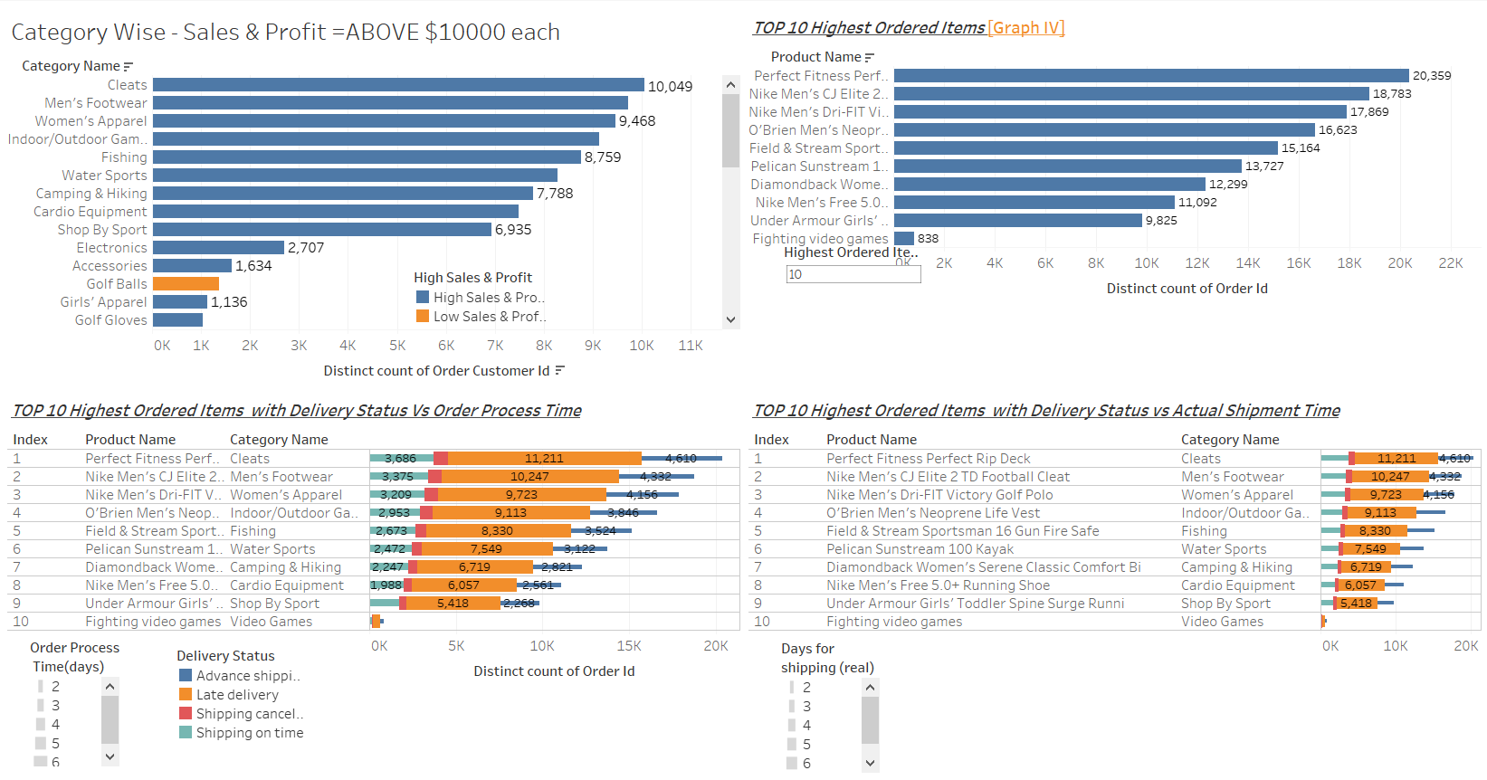
RECOMENDATIONS – for Minimizing ‘LATE DELIVERY RISK’ factor in SCM.
Analyzing the ‘High Sales & Profitable’ category of items,
Findings [ F 1/2 ]–
All these items have more than 50% of their orders delivered LATE due to HIGH Order Processing Time & HIGH Shipment Time.
Recommendations for [ F 1/2 ]-
High Order Processing Time & High Shipment Time can be due to lack of facilities at such warehouses from where the goods are dispatched. City-wise mapping may be done for Transport infrastructure & Workforce infrastructure improvement, at the Warehouse level.
After optimizing the warehouse performance, re-visit the ‘SHIPMENT Schedule days’ data declared to customer and revise it to factual shipment schedule days, if necessary.
Allocation of ‘Shipment Mode’ to be revised to meet customer expectations as well as match with warehouse infrastructure.
NOTE – Statistical Validation to be done every Three Months – MARKET Wise, for SCM optimization check.
Click for Live Visualisation

Slide 9
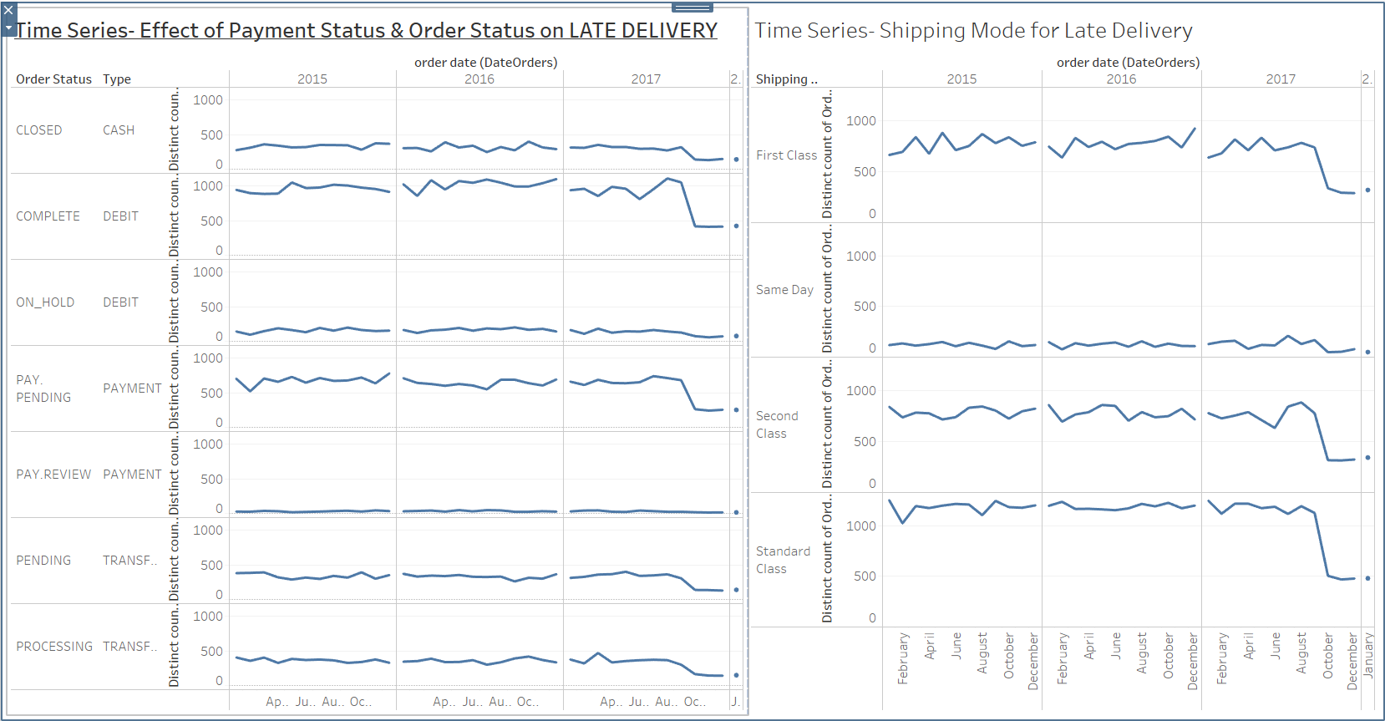
RECOMENDATIONS – for Minimizing ‘LATE DELIVERY RISK’ factor in SCM.
Analyzing the ‘TYPE of Payment made’ & ‘ORDER Status’,
Findings [ F 2/2 ]–
A Time Series analysis of the ‘Order Fulfillment’ factor is done with respect to ‘Late Delivered Orders’.
It is found that Orders for which payment has been received through DEBIT Mode and have been processed- ARE LATE DELIVERED.
Also ALL Orders that has taken the ‘STANDARD CLASS’ of shipment method, HAS BEEN LATE DELIVERED.
Recommendations for [ F 2/2 ] -
Internal administrative review of procedure followed for ORDER PROCESSING for orders received against DEBIT payment – NEED TO BE DONE.
‘STANDARD CLASS’ shipment method should be made more efficient.
NOTE – Statistical Validation to be done every Three Months – MARKET Wise, for SCM optimization check.
Click for Live Visualisation

Slide 10


